Slide 1
Programming Principle and Techniques
INPUT AND OUTPUT & OPERATORS AND EXPRESSIONS
Notes:
1-13

Slide 2
Learning Outcomes
By the end of this part, you should be able to:
Use the printf() statement to produce output on the screen using a particular format
Use the scanf() statement to read input from the keyboard using a particular format
Write appropriate statements using five types of operators
Write arithmetic expressions using C syntax
Write expressions for assignment statements
Notes:
1-13

Slide 3
Introduction
Input from keyboard and output on the screen
  Input – scanf()
  Ouput – printf()
Both of these functions are called from the standard C library called stdio.h
Operators: arithmetic, relational, logic, increment & decrement, cast and conditional
Notes:
1-13

Slide 4
printf() Function
This function is meant for printing to the computer screen, not to the printer
Format:
  printf(output_format [,value_list]);
  output_format:an array that will determine the form of the output depending on the value list
  value_list: can be made up of variables, constants, statements or combinations
Notes:
1-13

Slide 5
Printing Strings
Example: printf(“Welcome to UNITAR”);
Output: Welcome to UNITAR
All characters in double quotes (“ ”) will be printed including the spaces
This statement does not execute a new line automatically. Meaning that the cursor placed on the screen at the end of the last printed character
The next printf() statement can be printed on the next line if you put an escape sequence character ‘\n’
Notes:
1-13

Slide 6
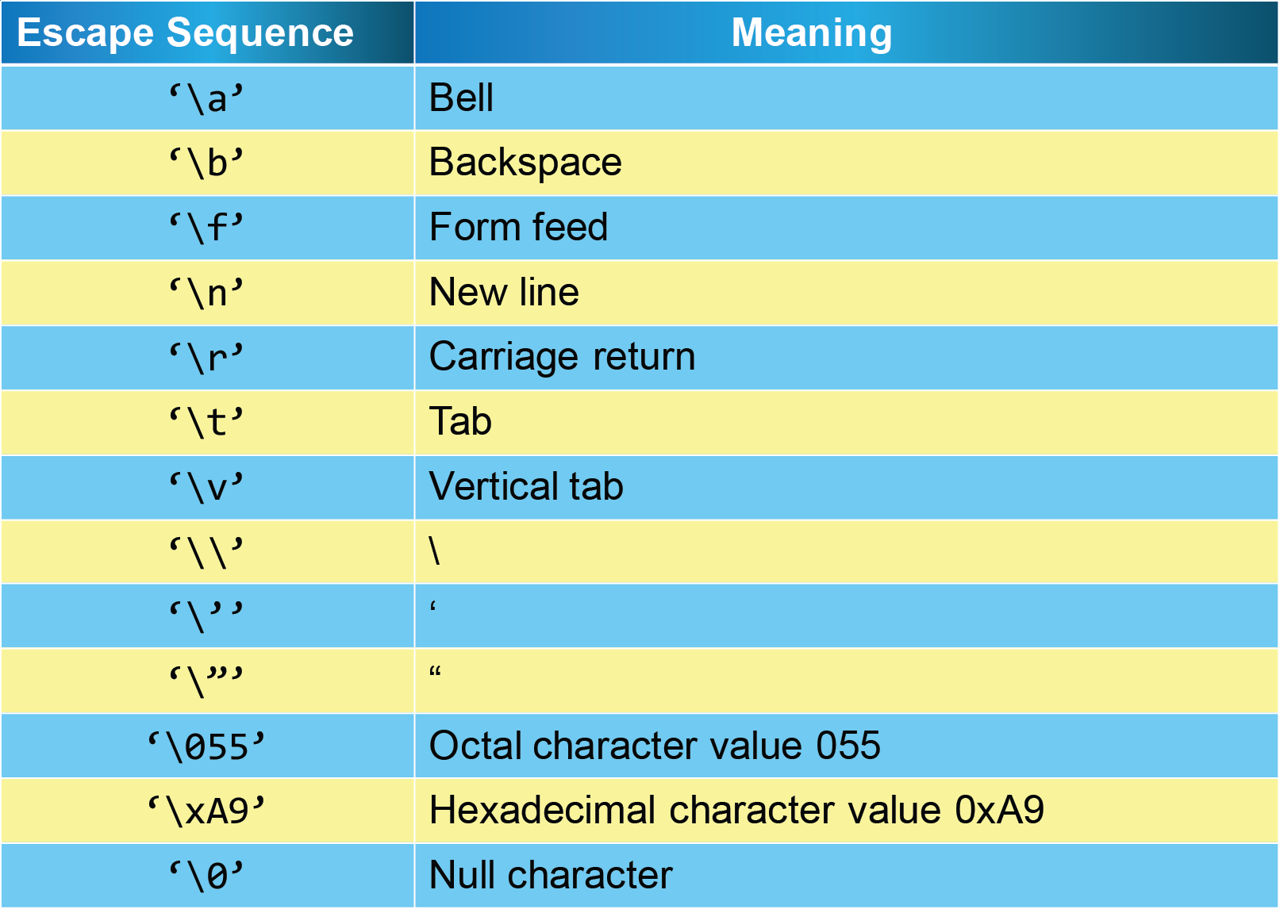
Escape Sequence Characters
<number> - 13
Notes:
1-13

Slide 7
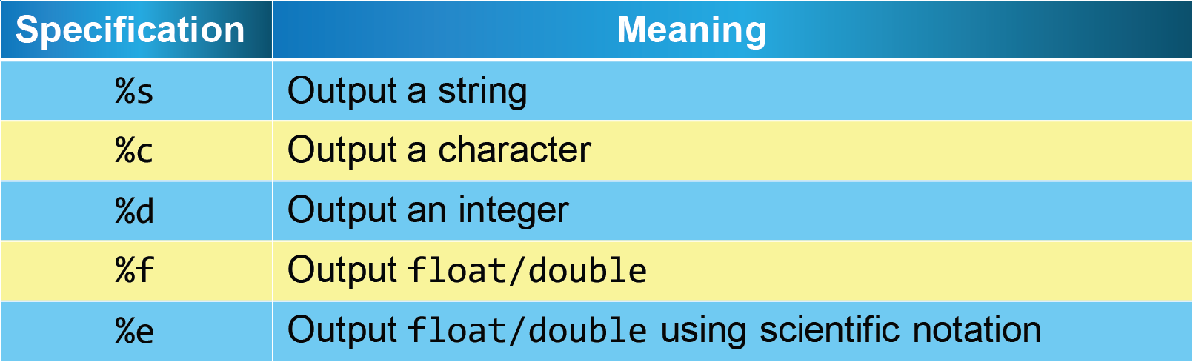
Printing Values
If printf() function call has a list of values to be printed, then the output_format must use specifications for those values
Notes:
1-13

Slide 8
%s Specification
Program:
/* Prints name */
#include <stdio.h>
void main()
{
char name[]=“Rohaizak Omar”;
printf(“%s”, name);
}
Output:
Rohaizak Omar
Notes:
1-13

Slide 9
%s Specification
Program:
/* Prints characters */
#include <stdio.h>
void main()
{
char letter1=‘U’, letter2=‘I’, letter3=‘U’;
printf(“%c%c%c”, letter1, letter2, letter3);
}
Output:
UIU
Notes:
1-13

Slide 10
%d and %f Specification
Program:
/* Printing integer and real values */
#include <stdio.h>
void main()
{
int value1;
float value2;
value1=10;
value2=5.55;
Notes:
1-13

Slide 11
%d and %f Specification (cont.)
printf(“First value = %d\n”, value1);
printf(“Second value = %f\n’, value1-value2);
}
Output:
First value = 10
Second value = 4.450000
Notes:
1-13

Slide 12
scanf() Function
This function is meant to get input from keyboard, as well as interact with the written program
Format:
  scanf(input_format [,variable_list]);
  input_format: a string that will determine the form of input string
  variable_list: list of variable to represent the input string
Notes:
1-13

Slide 13
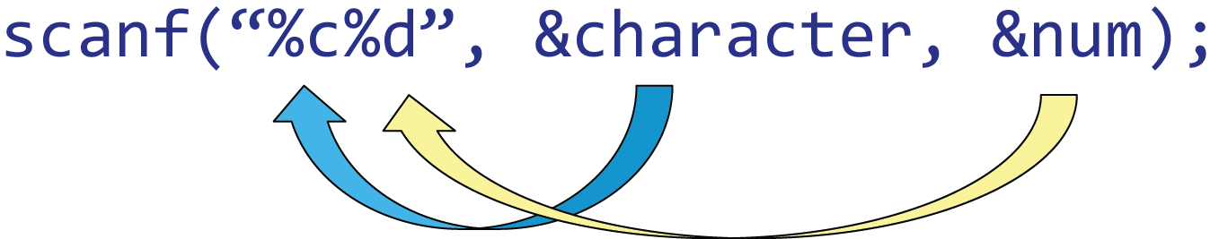
scanf() Function
For basic variable input (integer, real & character), we need to list the address location of the variables
The address location uses the & operator for the list of variables
Example:
Notes:
1-13

Slide 14
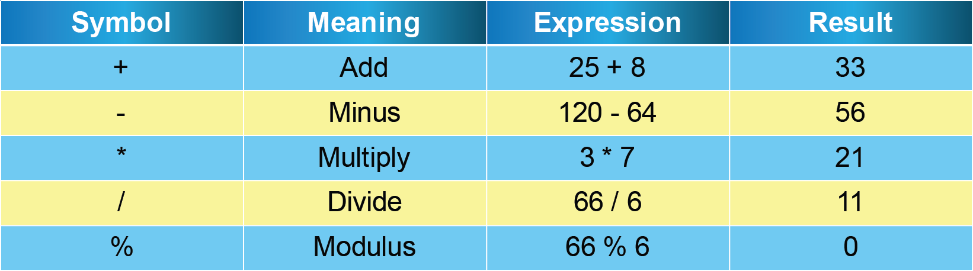
Basic Arithmetic Operators
Note:
Most of the symbols behave in the same way as normal arithmetic operations except for:
  Multiplication uses * symbol, not x symbol
  The division operators also different in terms of their symbols and operands either the integer division or the real division
Notes:
1-13

Slide 15
Integer Division
Integer division happens when both of the operands are of the integer type
Operands can be a constant or a variable
Example:
  8/2 /*constant divide constant*/
  98/value /*constant divide variable, value*/
  total/3 /*variable divide constant*/
  total/count
Notes:
1-13

Slide 16
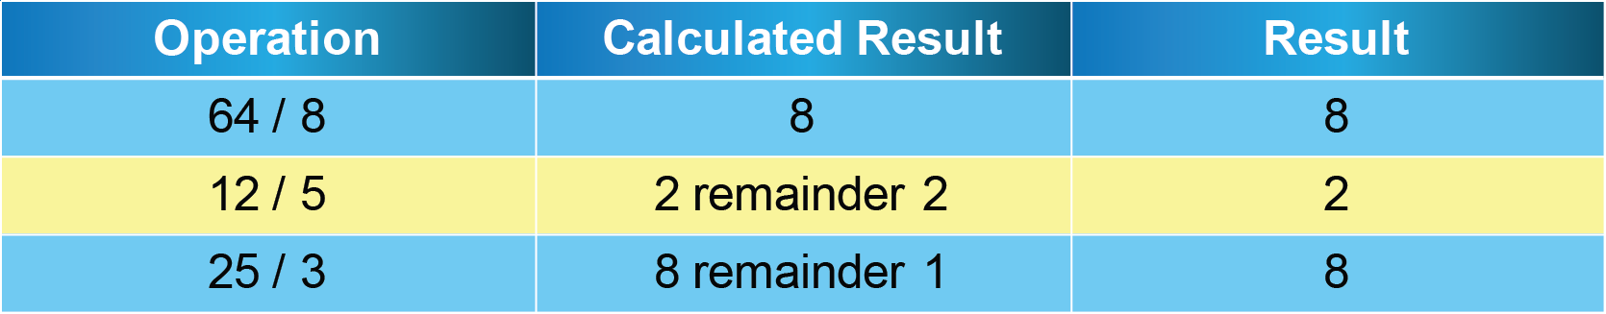
Real Constants
If the division is not a round number, therefore the remainder of the division is ignored
The result is truncated to an integer value
Notes:
1-13

Slide 17
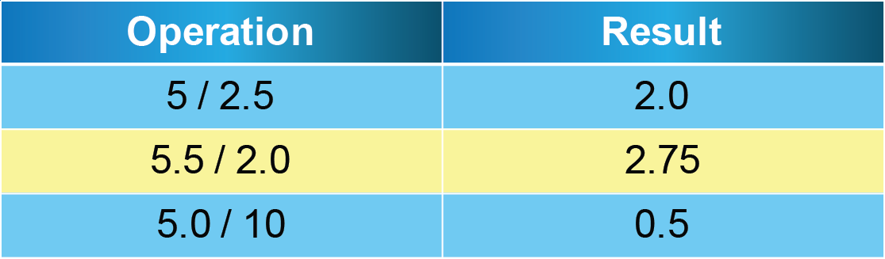
Real Division
Real division is done when one or both of the operands have a real value
The result of the division is a real value
Notes:
1-13

Slide 18
Arithmetic Expressions
C arithmetic operations are a combination of one or more arithmetic operations
These arithmetic expressions can represent algebra expressions
Examples:
  5 + 6
  14 * 5 * 2
  21 – 6 + 7 * 4 / 2
  7.5 * (2.0 – 4.52)
Notes:
1-13

Slide 19
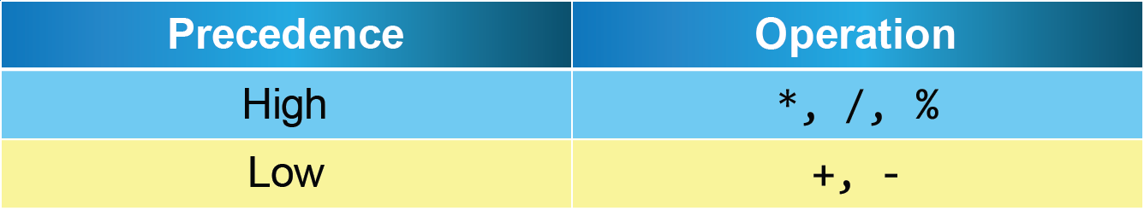
Precedence Level
Precedence level would determine the arithmetic operation sequence in solving the problem
Rules:
  Solve in bracket first
  Solve high precedence from left to right
  Solve low precedence from left to right
Notes:
1-13

Slide 20
Precedence Level
Example:
  4 + 5 * (10 – 8) / 2
  4 + 5 * 2 / 2 ..........(Rule No.1)
  4 + 10 / 2 ..............(Rule No.2)
  4 + 5 ...................(Rule No.2)
  9 .......................(Rule No.3)
Notes:
1-13

Slide 21
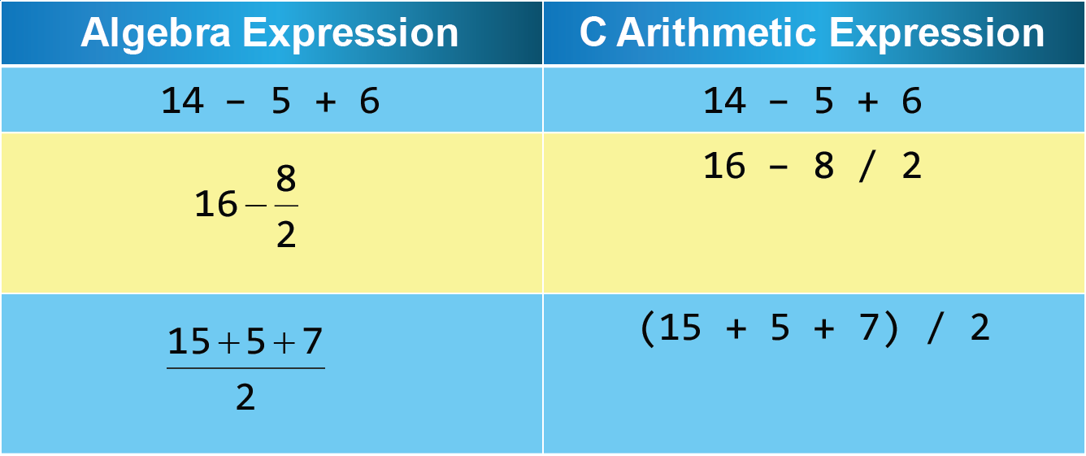
Writing Arithmetic Expressions in C
To convert algebra expressions to the C arithmetic expressions, be careful with the precedence level
Notes:
1-13

Slide 22
Assignment Statement (=)
Format: variable = expression;
Rule: expression will be evaluated and the value (on your right) is assigned to the variable (on your left)
(Your Right)
Value
Variable
Variable + value
(Your Left)
- Variable only
Notes:
1-13

Slide 23
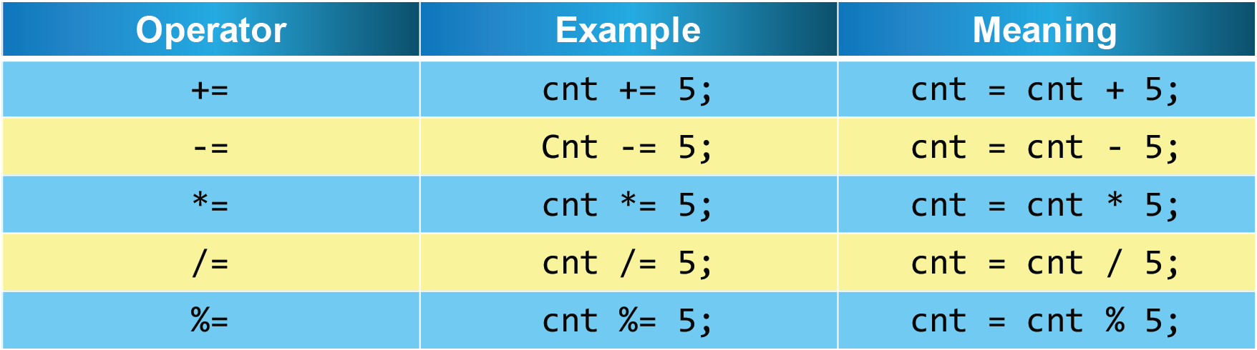
Compound Assignment Statement
Compound assignment statement is used to modify a variable’s value where the original value is added to or multiplied by another value and is assigned back to the original variable
Example: weight = weight + 2;
Notes:
1-13

Slide 24
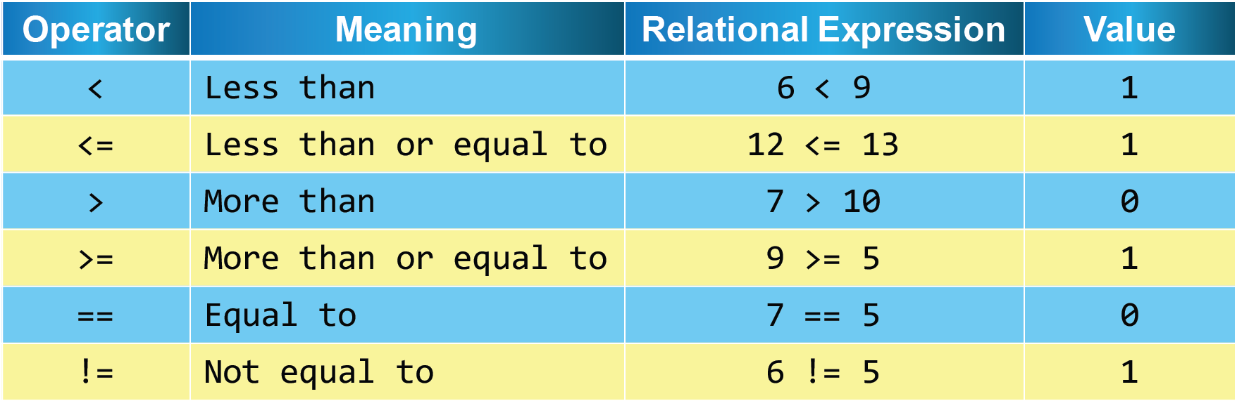
Relational Operator
This operator is used to compare data
Notes:
1-13

Slide 25
Relational Operator (cont.)
This operator has 2 operands (either variable, constant or combination)
Relational expression will return 1 if true, and 0 if false
Notes:
1-13

Slide 26
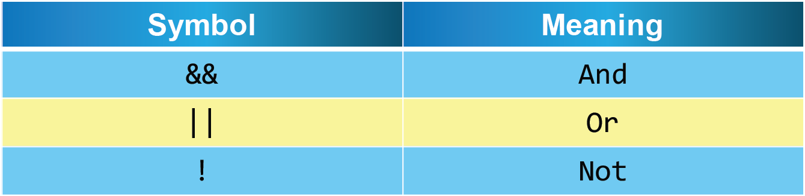
Logical Operator
This operator is used to test a few cases that are related to get a result
Operator && and || must have two operands whereas the operator ! has only one operand
Notes:
1-13

Slide 27
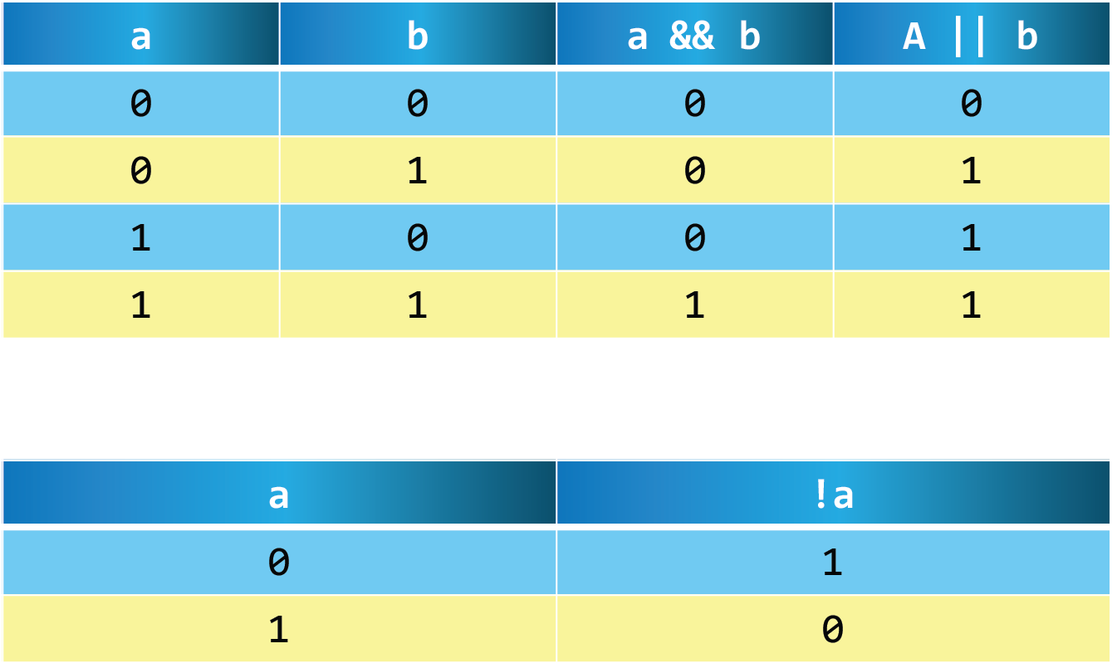
Logical Operator
Notes:
1-13

Slide 28
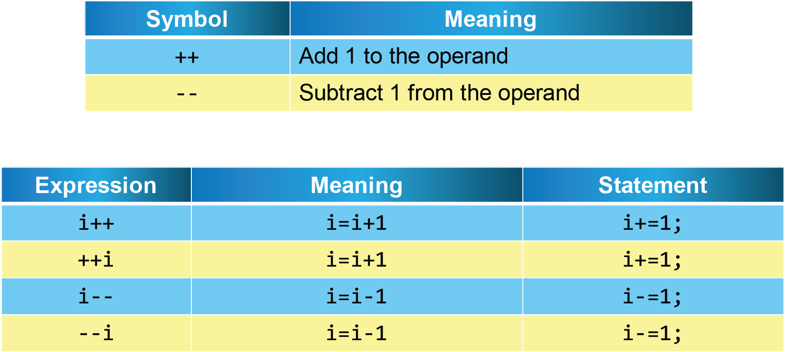
Increment and Decrement Operators
Notes:
1-13

Slide 29
Increment and Decrement Operators
To increase or decrease the value of one variable, the position of the operator does not matter, whether it is a prefix or postfix of the variable
However, when the operator is combined to other operators in an expression, the position would determine the value returned
Notes:
1-13

Slide 30
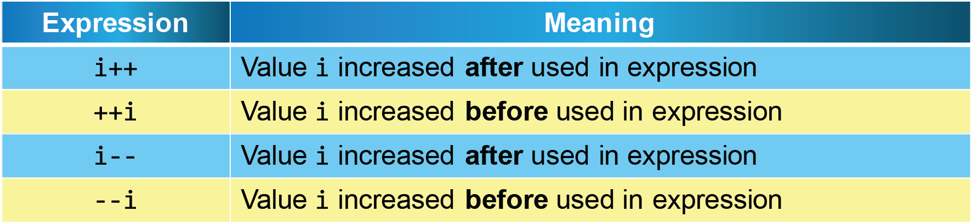
Increment and Decrement Operators (cont.)
Notes:
1-13

Slide 31
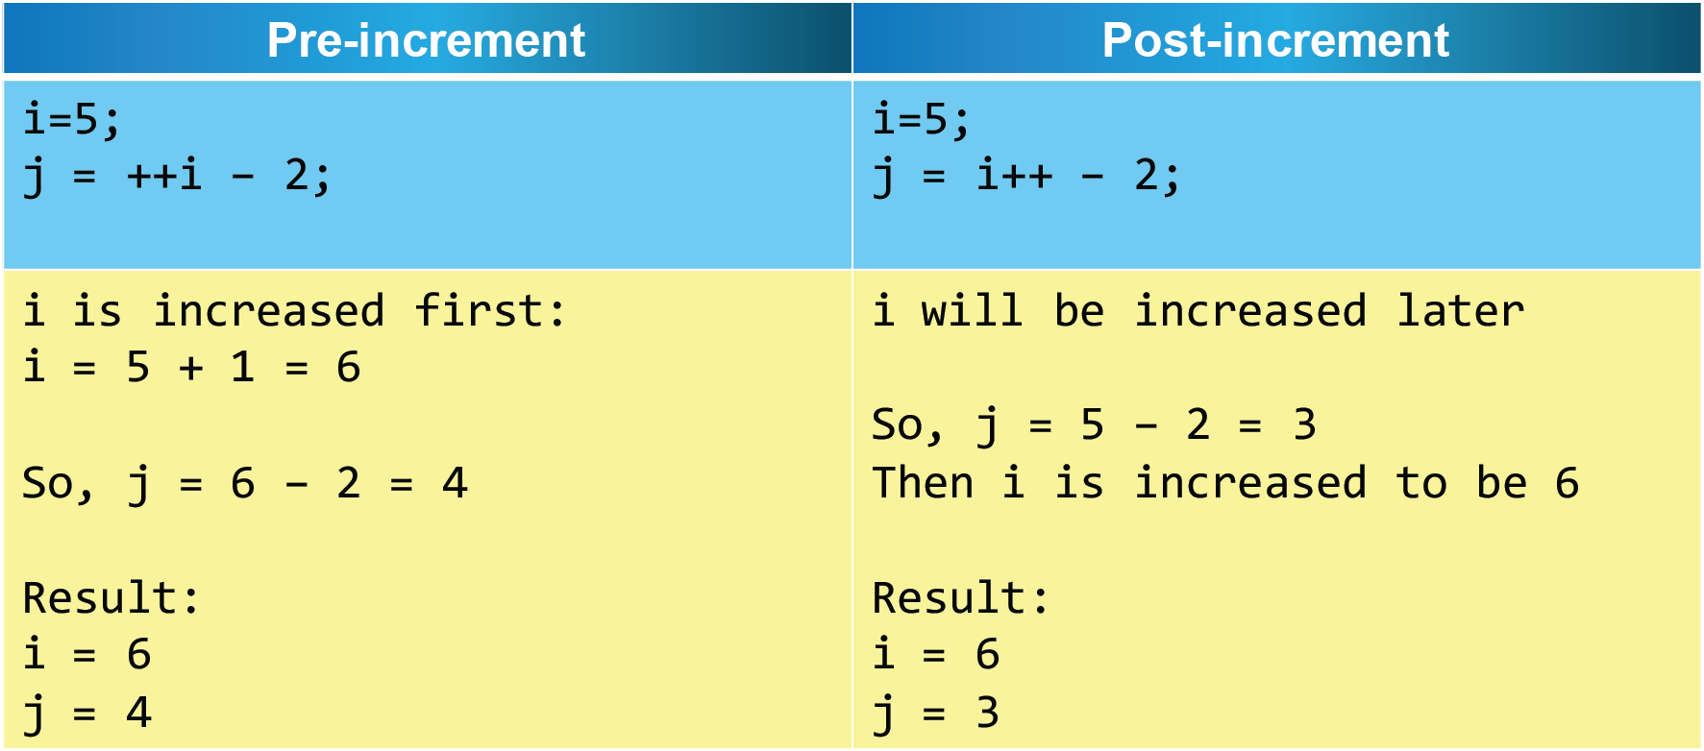
Increment and Decrement Operators
Notes:
1-13

